Slide 1
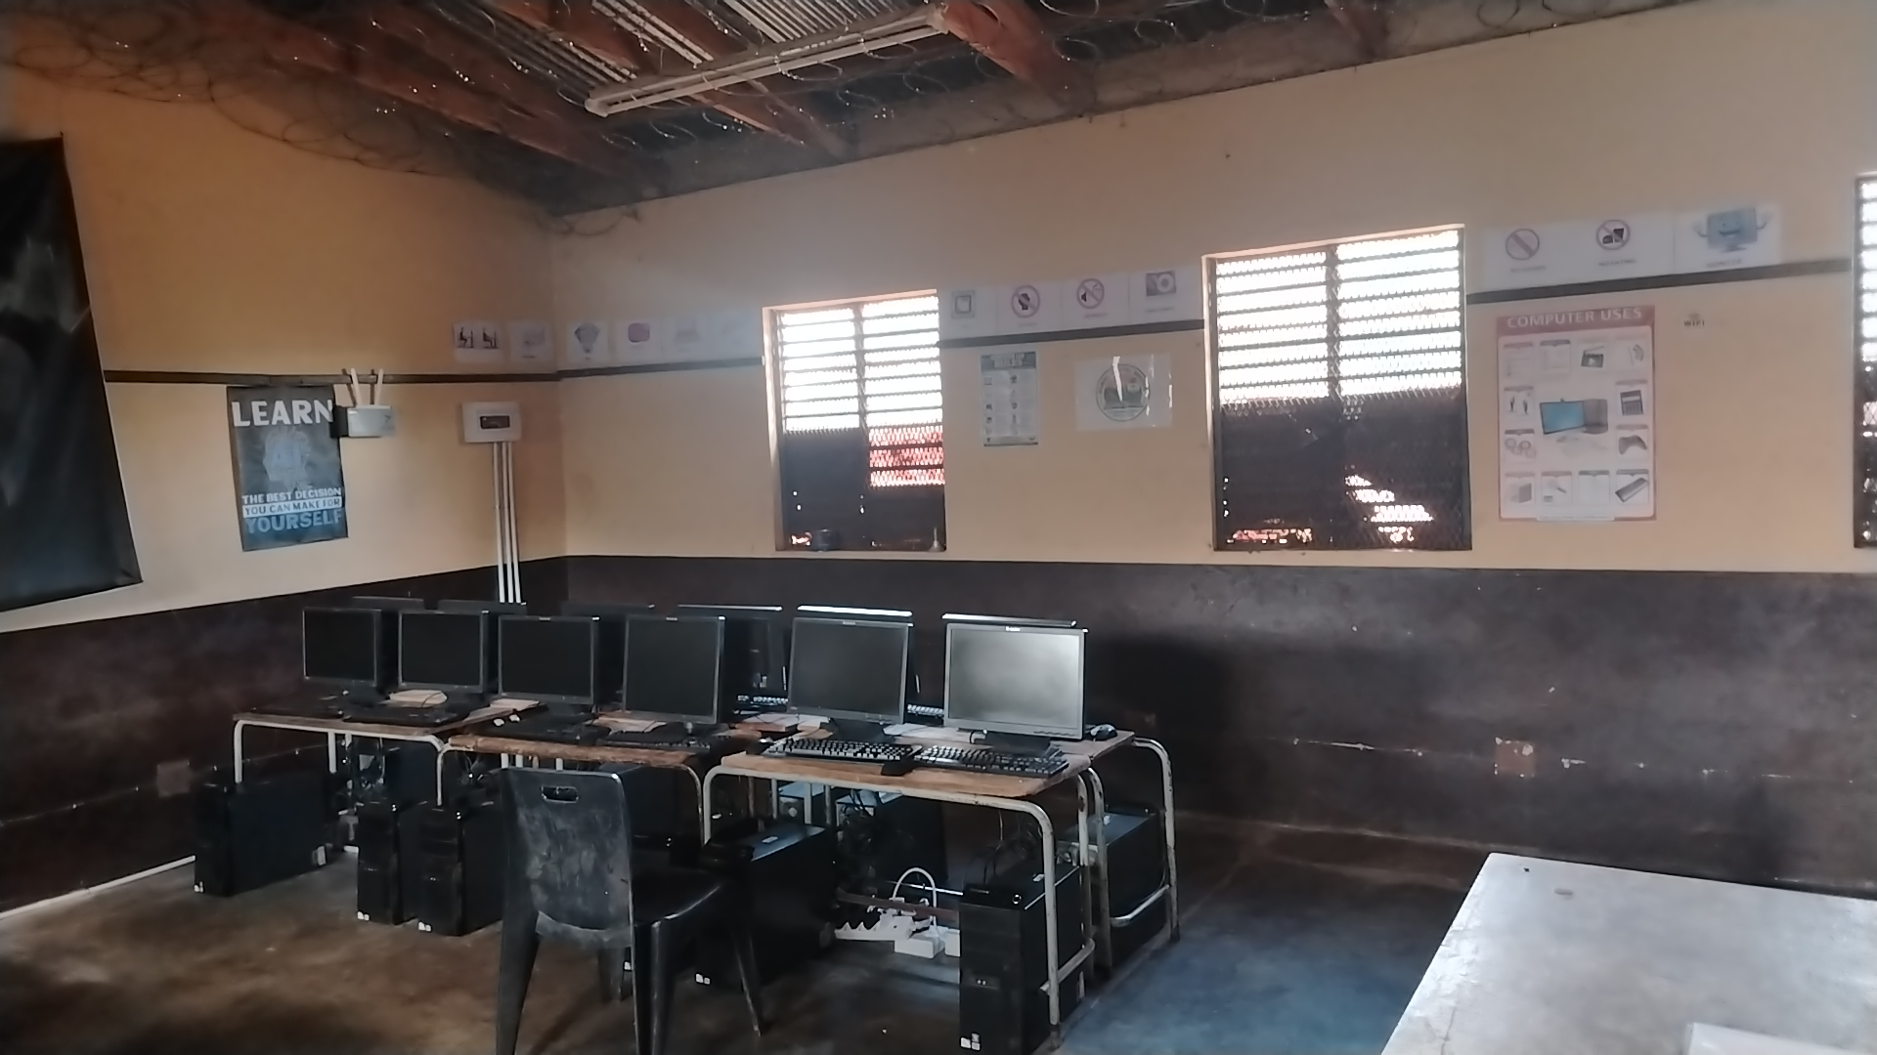

Nong Modikwa
Primary School
DIGITAL TRANSFORMATION PLATFORM
Building a Smart, Connected and Future-Ready Rural School
Motto: Strive for Excellence
Hwibi Village · Ga-Matlala · Limpopo · EMIS 922250850
Nong Modikwa Primary School · Digital Transformation Platform
1
Notes:
Welcome everyone. Introduce the school, the motto 'Strive for Excellence', and explain that this presentation tells the story of our digital transformation journey.

Slide 2
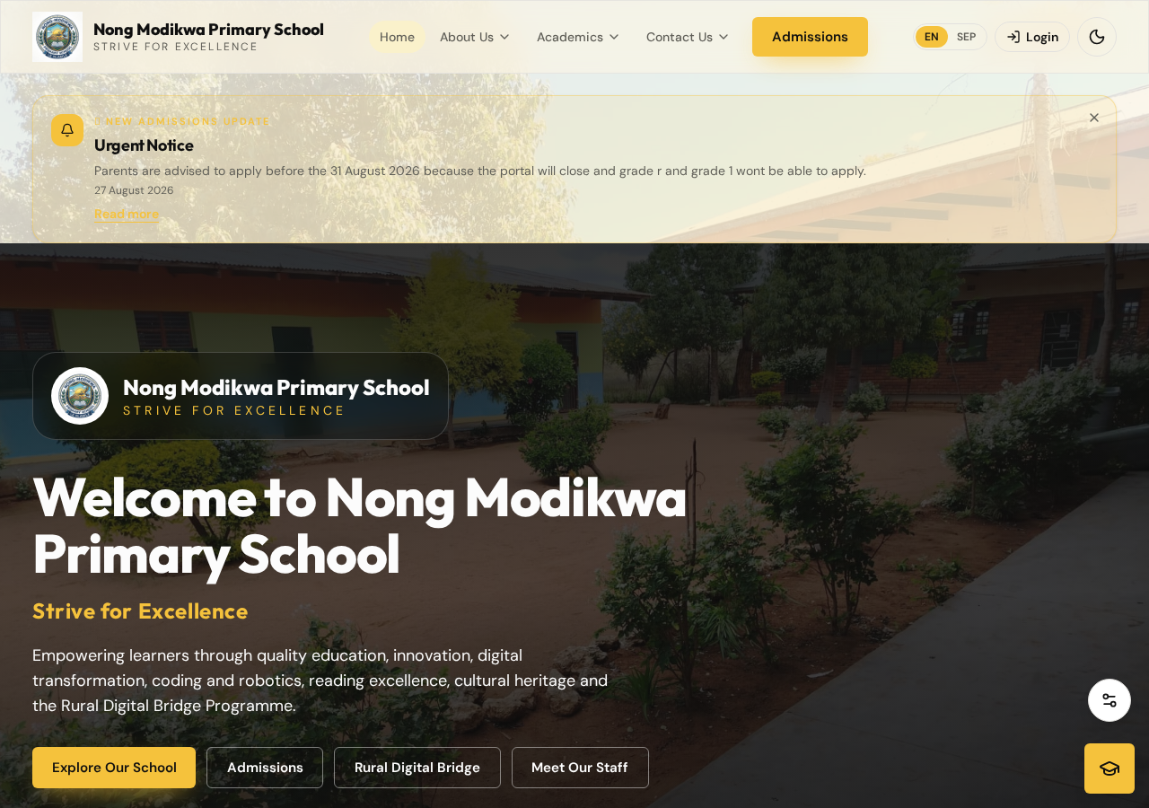
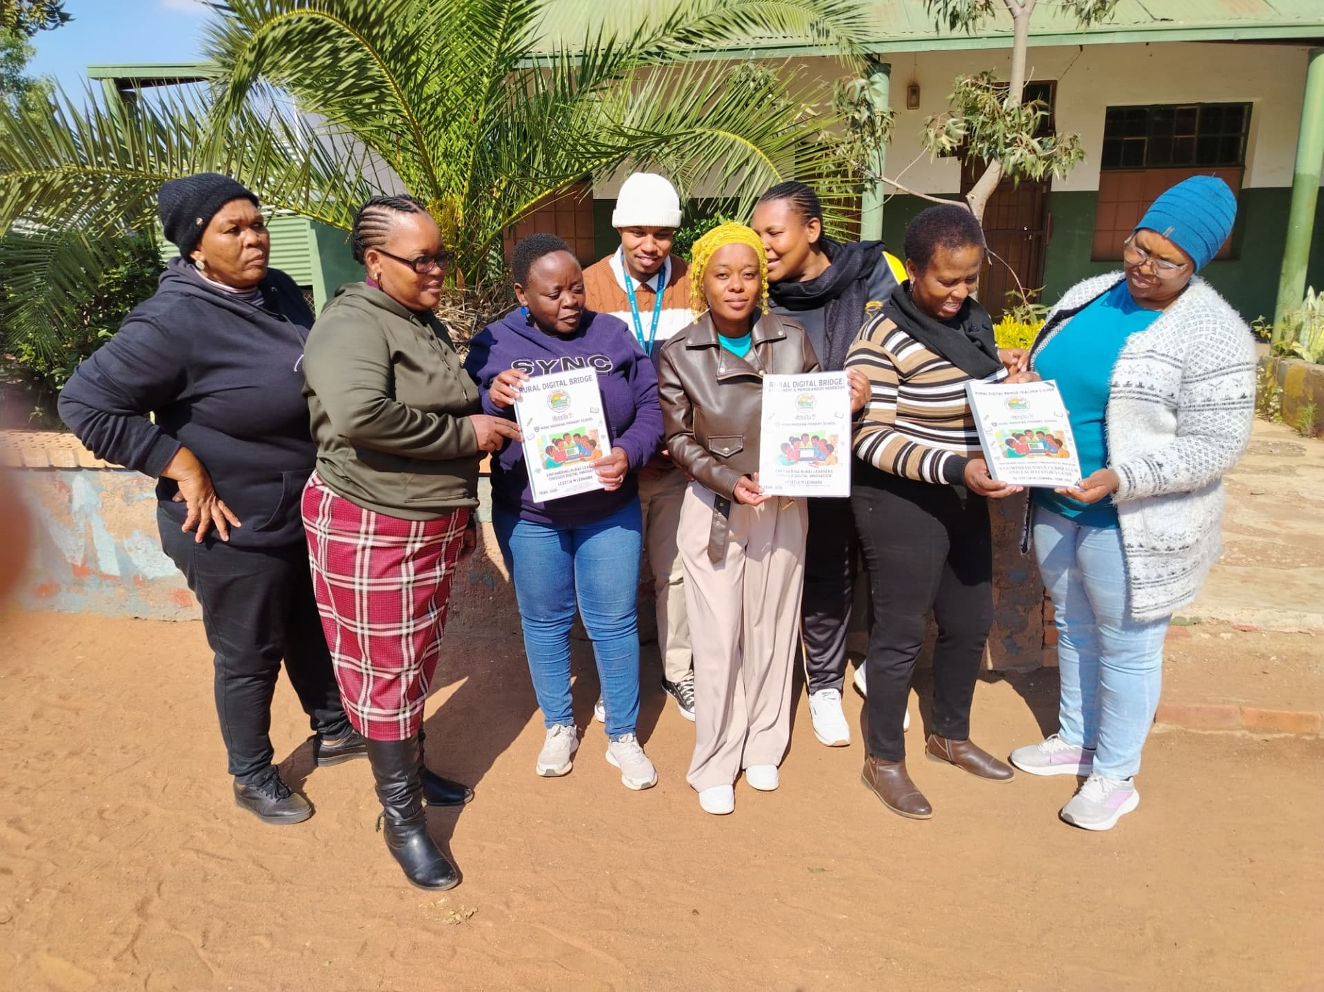
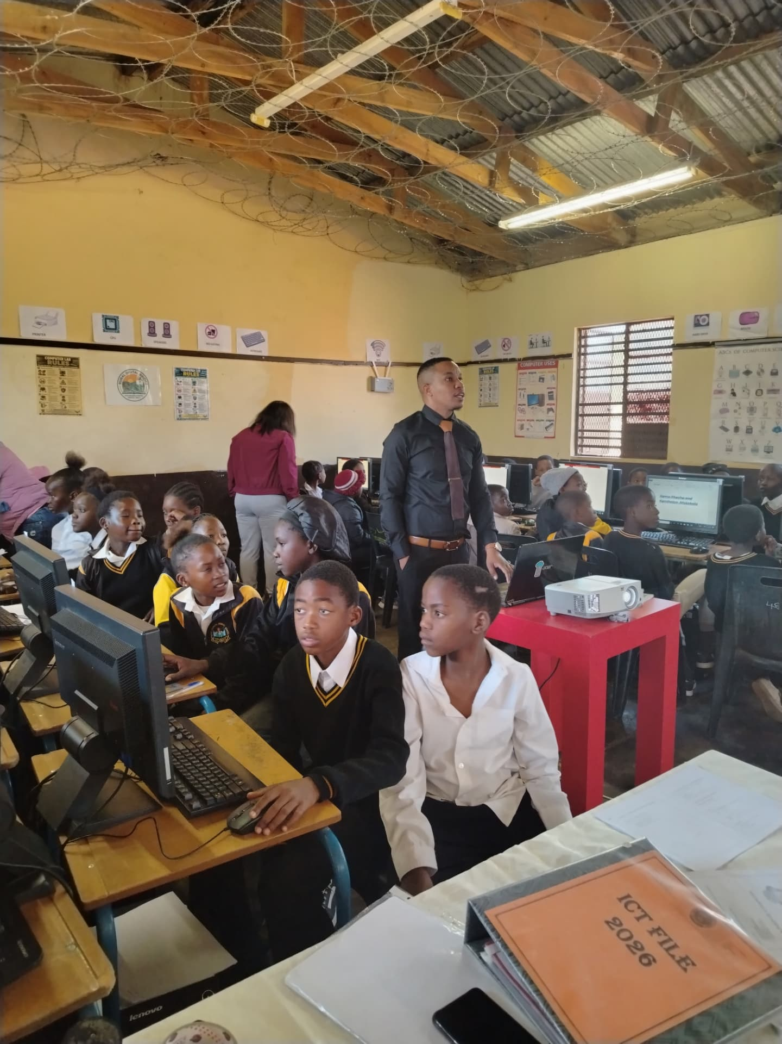
Our Digital Transformation Journey
Why Nong Modikwa Primary School is building an integrated digital platform
▪ Digital transformation of a rural public primary school, driven from inside the school.
▪ Faster, clearer communication with parents, learners and the wider community.
▪ Support for learners through digital learning, AI assistance and reading resources.
▪ Support for educators with digital planning, assessment and teaching resources.
▪ Support for management with a single, secure administration dashboard.
▪ Better administration: records, LTSM, library, achievements and documents in one place.
▪ Connecting the school community, universities, partners and donors.
▪ Preparing learners for a changing, technology-driven world.
Nong Modikwa Primary School · Digital Transformation Platform
2
Notes:
Explain that the platform grew from a practical need: one place where school information lives, is managed and is shared.

Slide 3
Why Digital Transformation Matters
The challenge and the opportunity
Digital inequality
Rural learners have fewer digital opportunities
Rural access challenges
Distance, connectivity and resources
Limited access to technology
Devices and laboratories are scarce
Need for digital literacy
A basic skill for every learner today
Artificial Intelligence
Already shaping learning and work
Coding and robotics
New curriculum, new skills
School communication
Information must reach parents quickly
School administration
Accurate records and accountability
Future opportunities
Skills that open doors beyond the village
Digital transformation is not only about computers.
It is about creating access, opportunity, knowledge and a better future.
Nong Modikwa Primary School · Digital Transformation Platform
3
Notes:
Frame the national and local challenge before showing the school's response.

Slide 4
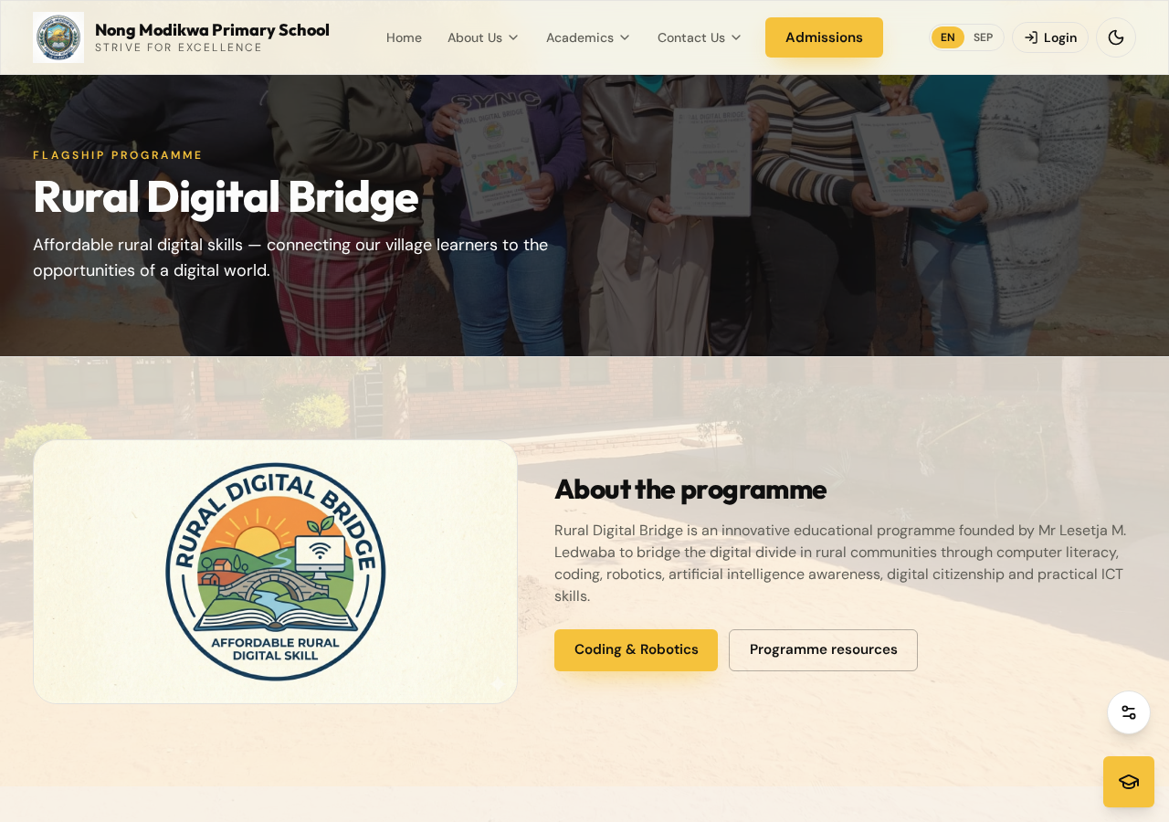
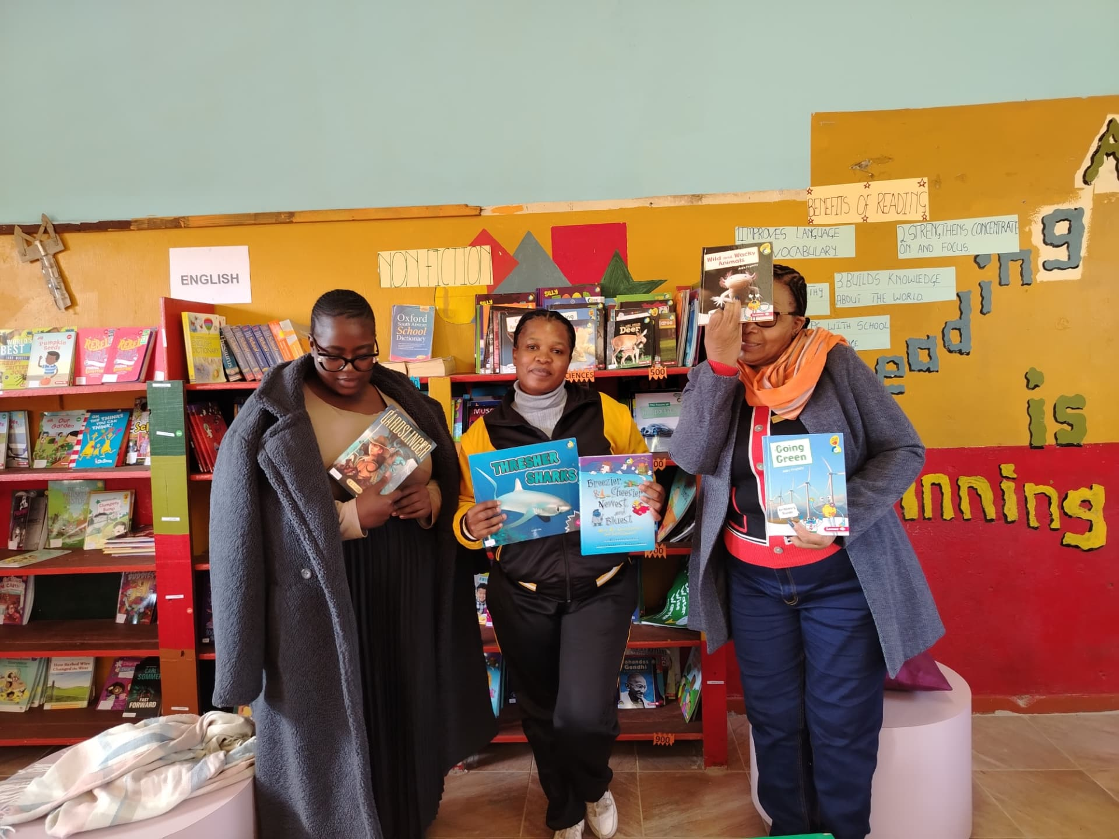
Supporting South Africa's Digital Education Vision
National policy alignment
“Every South African manager, teacher and learner in the General and Further Education and Training bands will be ICT capable, that is, use ICTs confidently and creatively to help develop the skills and knowledge they need as lifelong learners, to achieve personal goals, and to be full participants in the global community.”
Department of Education, White Paper 7 on e-Education (2004)
ICT SUPPORTS:
Teaching and learning
Digital skills
School management
Administration
Curriculum integration
Communication
Collaboration
Creativity
Problem-solving
Nong Modikwa Primary School · Digital Transformation Platform
4
Notes:
Read the White Paper 7 quotation and connect it to what the school is doing in practice.

Slide 5
From National Vision to Rural School Innovation
Turning policy into practice at Nong Modikwa
South African Digital Education Vision
Department of Education ICT Policy
Digital Transformation in Schools
Nong Modikwa Primary School Digital Platform
+ Rural Digital Bridge Programme
Digital Skills and Innovation
Digitally Empowered Learners and Educators
Future-Ready Rural Communities
Nong Modikwa Primary School · Digital Transformation Platform
5
Notes:
Walk down the chain: national vision, policy, school platform, and finally empowered learners and communities.

Slide 6
A Continuing Digital Education Journey
Technology keeps changing — schools keep adapting
2004
2010s
2020s
Now
Next
White Paper 7 on
e-Education
Growth of ICT
in Education
Digital Infrastructure
and Connectivity
Digital Education
Strategy Development
Future-Ready
Schools
Technology continues to evolve, and schools must continue adapting to prepare learners and educators for a rapidly changing digital world.
Nong Modikwa Primary School · Digital Transformation Platform
6
Notes:
Emphasise that this is a journey, not a once-off project.

Slide 7
Creating a Connected School Ecosystem
One platform, many stakeholders
Educators
School Management
Parents
Learners
Community
NONG MODIKWA
DIGITAL PLATFORM
Universities
Donors and Funders
Strategic Partners
Researchers
Nong Modikwa Primary School · Digital Transformation Platform
7
Notes:
Show how the platform connects every part of the school community.

Slide 8
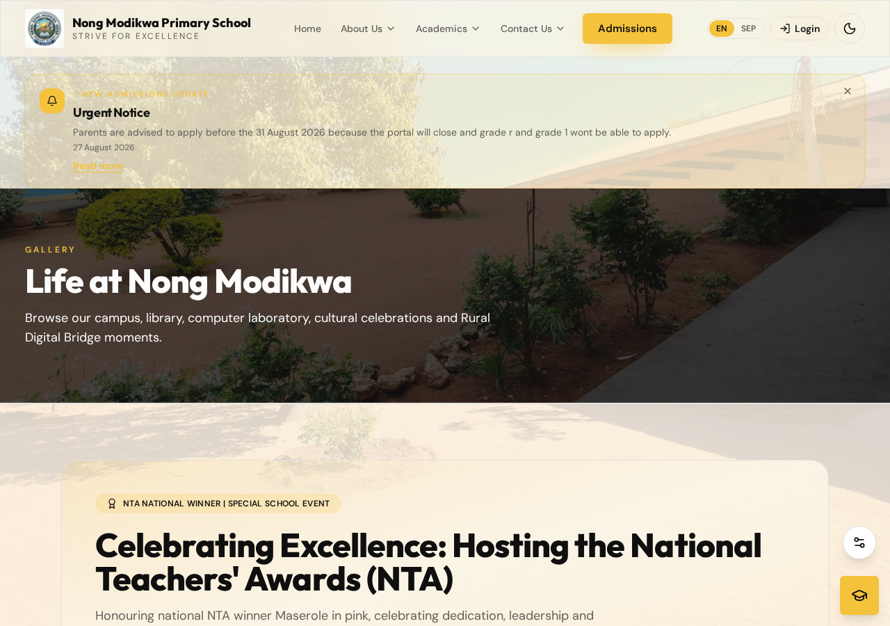
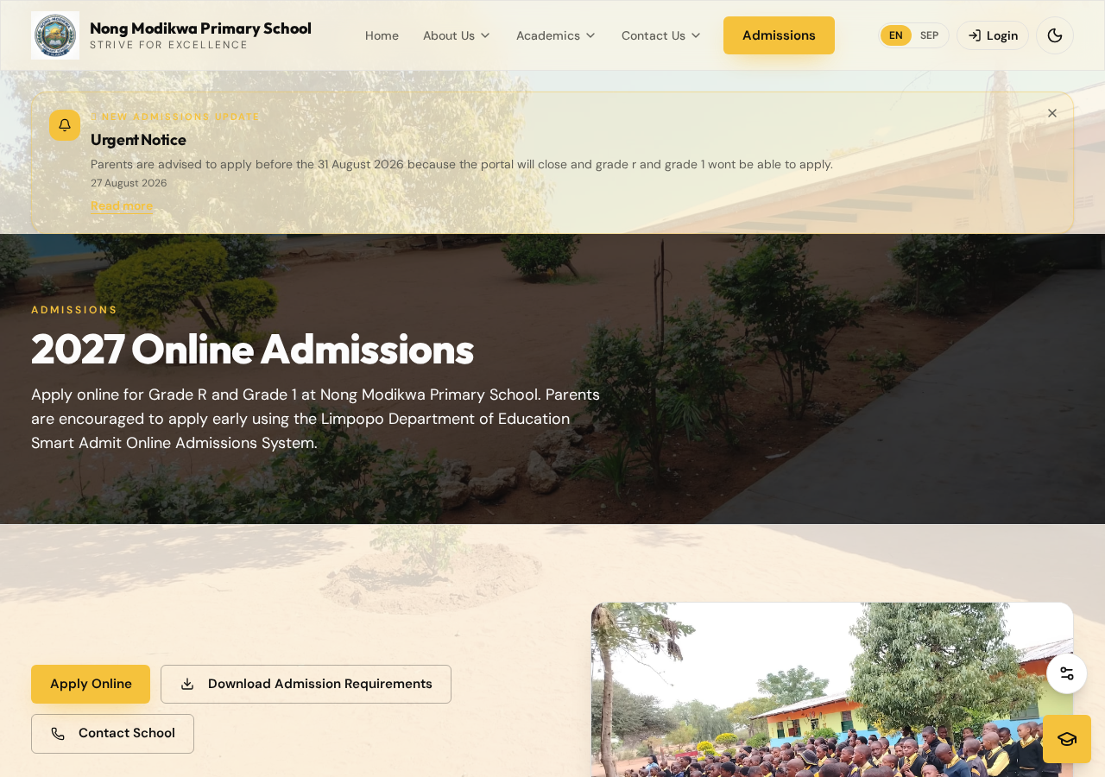
One Digital Platform — Multiple School Services
The public school website
School information
Announcements
News and events
Admissions
Academics
Timetables
Programme of Assessment
Downloads
Gallery
Rural Digital Bridge
Coding and Robotics
Library
Sports
Culture and Heritage
Donations
Student Teachers
Vacancies
Tenders
Strategic Partners
Nong Modikwa Primary School · Digital Transformation Platform
8
Notes:
Point out the breadth of services already live on the public website.

Slide 9
Where Does the Nong Modikwa Digital Platform Fit?
Working alongside existing education systems — not replacing them
OFFICIAL GOVERNMENT AND EDUCATION SYSTEMS
🛡 SA-SAMS
Official School Administration and Management System
Learner records · Educator information · Attendance · Official reporting
🔒 TRIPLE D / DDD
Official Departmental Digital System
Departmental digital information and reporting processes
Official Systems · Authorised Data · Government-Controlled Access
APPROVED / AUTHORISED INFORMATION ONLY
NONG MODIKWA PRIMARY SCHOOL DIGITAL PLATFORM
The School's Digital Engagement and Service Layer · Website · Dashboard · AI Assistant · Announcements · Academics · Downloads · Library · LTSM · Gallery · RDB · Coding and Robotics
APPROPRIATE INFORMATION FOR THE SCHOOL COMMUNITY
Learners
Educators
Principal
Management
Parents
Community
Student Teachers
Universities
Partners
Guests
ROLE-BASED ACCESS
SENSITIVE DATA REMAINS PROTECTED
The website does not replace SA-SAMS, Triple D/DDD or any
other official system, and has no direct integration with them.
Only approved, appropriate information is shared.
Principal / Administrator → full authorised access
Management → relevant management access
Educators → teaching and school information
Learners → approved learning information only
Parents and Public → public, non-sensitive information only
Nong Modikwa Primary School · Digital Transformation Platform
9
Notes:
Be explicit: the platform does not replace SA-SAMS or Triple D/DDD and has no direct integration with them. It shares only approved information.

Slide 10
Complementary Systems, Working Together
How the three systems relate
SA-SAMS
Official school administration
and record-keeping
TRIPLE D / DDD
Official departmental
digital system
NONG MODIKWA DIGITAL PLATFORM
Communication, engagement, digital services,
AI support and approved information access
“Complementary systems, working together for a digitally connected school.”
FROM OFFICIAL SYSTEMS TO SCHOOL SERVICES — THE NONG MODIKWA DIGITAL PLATFORM CONNECTS APPROVED INFORMATION WITH THE PEOPLE WHO NEED IT, WHILE PROTECTING SENSITIVE DATA.
No direct integration with SA-SAMS or Triple D/DDD is claimed or implemented. Any future integration would require official authorisation.
Nong Modikwa Primary School · Digital Transformation Platform
10
Notes:
Reinforce the complementary relationship and the closing statement.

Slide 11
A Modern, Responsive School Website
Designed for desktop, tablet and mobile
▪ Responsive design — desktop, tablet and mobile
▪ School branding in black, white and yellow
▪ Clear five-tab navigation with dropdown menus
▪ Light and dark mode
▪ English and Sepedi language switch
▪ Accessible, fast-loading pages
▪ Notification balloons for urgent notices
Live homepage of the Nong Modikwa Primary School website
Nong Modikwa Primary School · Digital Transformation Platform
11
Notes:
Show the responsive, branded interface with light and dark mode and clear navigation.

Slide 12
Meet the Nong Modikwa AI School Assistant
A digital school front office, available on every page
Digital school front office
Answers school questions any time
School information assistant
Admissions, events, contacts, documents
Learner assistant
Friendly help for Grades R–7
Homework explanation
Explains concepts, does not do the work
Study Mode
Guided revision and explanations
Quiz Mode
Practice questions with feedback
English support
Sepedi support
Grade R–7 support
CAPS-related assistance
School information
RESPONSIBLE USE
The assistant must not provide direct answers to formal tests or examinations.
It explains, guides and encourages learners to think — and refers users to school management when information is not confirmed.
Nong Modikwa Primary School · Digital Transformation Platform
12
Notes:
Stress that the assistant supports learning but never provides answers to formal tests or examinations.

Slide 13
AI Knowledge and Support
Approved school information powers the assistant
Announcements
News and Events
APPROVED INFORMATION
Gallery
Rural Digital Bridge
AI KNOWLEDGE BASE
Downloads
Donations
NONG MODIKWA AI SCHOOL ASSISTANT
Student Teachers
Vacancies
Tenders
Culture
HELPFUL AND RELEVANT ANSWERS
Sports
Admissions
NO GUESSING
If information is unconfirmed, the assistant must not invent an answer.
It directs users to official school management.
Programme of Assessment
Academic information
Nong Modikwa Primary School · Digital Transformation Platform
13
Notes:
Explain the knowledge pipeline and the no-invention rule.

Slide 14
A Central Digital Management Hub
The School Management Dashboard
Announcements
Circulars
News and Events
Gallery
Downloads
Staff information
Programme of Assessment
School achievements
Certificates
Homepage content
LTSM
Library
Rural Digital Bridge
Coding and Robotics
Tenders
Vacancies
User management
Website content
Chatbot knowledge
Security and audit
ONE SECURE, ROLE-CONTROLLED DASHBOARD
Only authorised users may sign in. Every module is protected by role-based access and enforced in the database itself.
Nong Modikwa Primary School · Digital Transformation Platform
14
Notes:
The dashboard is the single place where authorised staff manage everything the public sees.

Slide 15
Update Once, Inform Everywhere
One approved update reaches every channel
Dashboard
Approved Information
Database / Knowledge Base
Website Pages
Announcements and Notifications
Nong Modikwa AI School Assistant
Learners, Educators, Parents and Community
Nong Modikwa Primary School · Digital Transformation Platform
15
Notes:
This workflow is the heart of the platform: capture information once, publish it everywhere.

Slide 16
Protecting Information Through Role-Based Access
Security by design
Administrator
Full authorised access to all modules
Principal
Full school management access
Management
Relevant management modules
Educator
Teaching, planning and school information
Learner
Approved learning information only
Guest / Public
Public, non-sensitive information only
Role-based access
Protected administrative functions
Sensitive information protection
Backend authorisation
Restricted database access
View-only permissions
Audit and accountability
Secure sign-in and sessions
ENFORCED IN THE DATABASE, NOT ONLY IN THE INTERFACE
If an unauthorised user tries to bypass the interface, the database refuses the change and the action is denied.
Nong Modikwa Primary School · Digital Transformation Platform
16
Notes:
Explain that hiding buttons is not security: the database enforces every rule.

Slide 17
Open Information — Protected Administration
What learners, parents and the public can access
Home
About Us
School History
Principal's Office
Educators
Strategic Partners
Gallery
Academic information
Timetable
Programme of Assessment
Rural Digital Bridge
Coding and Robotics
Sports
Culture and Heritage
School Calendar
News and Events
Announcements
Downloads
Donations
Student Teachers
Vacancies
Tenders
VIEW · SEARCH · PRINT
Public users may read, search and print appropriate information, but may never modify administrative data.
Nong Modikwa Primary School · Digital Transformation Platform
17
Notes:
Everything a visitor needs is open; nothing administrative can be changed.

Slide 18
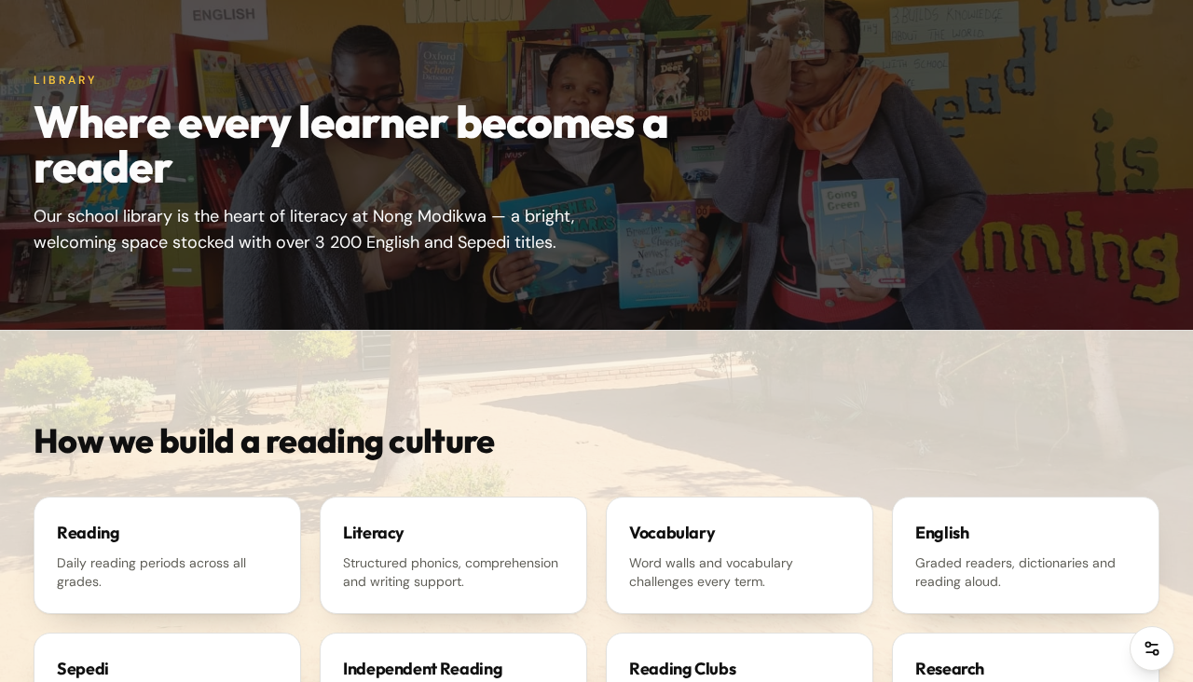
A Smarter School Library System
Digital catalogue, issuing and reading records
▪ Searchable book catalogue with full book details
▪ Live book availability
▪ Digital records replacing paper registers
▪ Book issue and return at the issuing desk
▪ Class reading register and printable attendance
▪ Teacher-librarian file and visitors' register
▪ AI assistant can help learners find books
RESTRICTED ADMINISTRATION
Adding, editing, issuing and auditing books is limited to:
Principal · Administrator · Library Coordinator · Library Committee
Everyone else has catalogue search only.
Nong Modikwa Primary School · Digital Transformation Platform
18
Notes:
The library system replaced paper registers with searchable digital records.

Slide 19
LTSM and Textbook Management
Accountability for every textbook
Grades 5, 6 and 7
Complete learner-by-learner registers
Textbook tracking
Issued, returned and outstanding books
Unique serial numbers
Validated on capture to prevent duplicates
Learner allocation
Linked to the master learner roster
Stationery management
Learner-teacher support material records
Receipt printing
Individual and full-class printable receipts
Search and bulk import
Fast capture and correction of records
Audit trail
Every change is recorded and traceable
IMPROVED ACCOUNTABILITY
Shortage summaries and quick-return ticks make stock-taking at the end of the year fast and accurate.
Nong Modikwa Primary School · Digital Transformation Platform
19
Notes:
Explain how serial numbers and receipts improved textbook accountability.

Slide 20
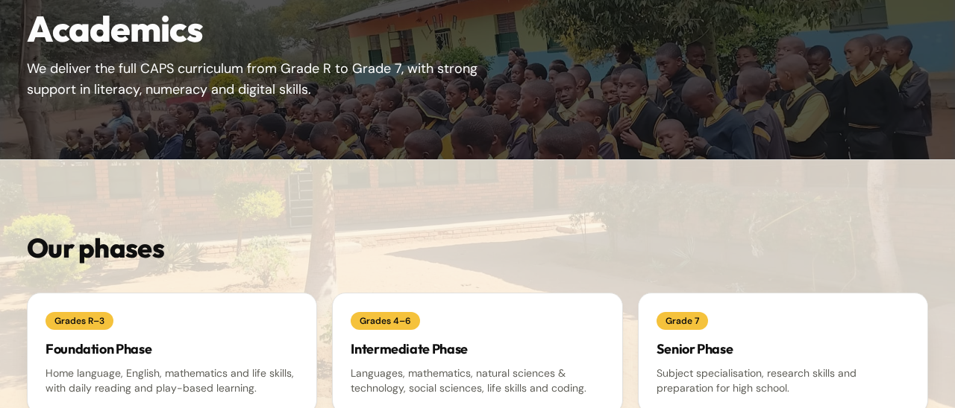
Supporting Teaching, Learning and Assessment
Academics, assessment and AI lesson planning
▪ Academic subjects and CAPS policy documents
▪ Foundation and Intermediate Phase timetables
▪ Programme of Assessment with live status colour-coding
▪ Examination and invigilation timetable
▪ AI-supported lesson planning from the school's ATP
▪ Educational downloads for educators and learners
Select Grade
Select Subject
Select Date
Upload or Use Saved ATP
AI Reads the Relevant ATP Content
AI Matches the Selected Date
AI Identifies Topic and Content
Generate Editable Lesson Plan
Print or Save Lesson Plan
Nong Modikwa Primary School · Digital Transformation Platform
20
Notes:
Introduce the AI lesson planner and stress that teachers review and edit every plan.

Slide 21
AI-Supported Lesson Planning in English and Sepedi
The plan follows the language of the ATP
English ATP
Sepedi ATP
AI Reads Relevant Content
AI Understands and Reads Sepedi
Identifies Relevant Date and Content
Generates Lesson Plan in English
Generates a Lesson Plan Entirely in Sepedi
RESPECT THE LANGUAGE OF THE SOURCE
A Sepedi ATP must result in a Sepedi lesson plan. The AI understands Sepedi headings, instructions, topics, learning content and dates,
and must not unnecessarily translate the lesson plan into English. Every generated plan remains editable, printable and saveable.
Nong Modikwa Primary School · Digital Transformation Platform
21
Notes:
A Sepedi ATP must produce a Sepedi lesson plan — no unnecessary translation.

Slide 22

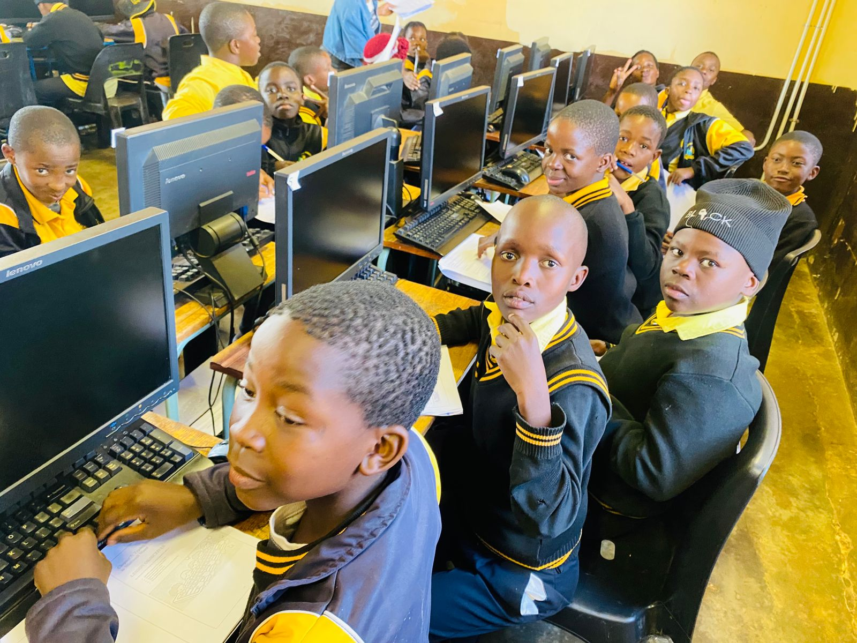
Bridging the Rural Digital Divide
The Rural Digital Bridge Programme
Digital literacy
Computer skills
Coding
Robotics
Digital citizenship
Online safety
AI awareness
Educational technology
Learner's Book
Teacher's Guide
Assessment and Memorandum Handbook
Nong Modikwa Primary School · Digital Transformation Platform
22
Notes:
Our flagship digital literacy programme, with its own learner book, teacher's guide and assessment handbook.

Slide 23
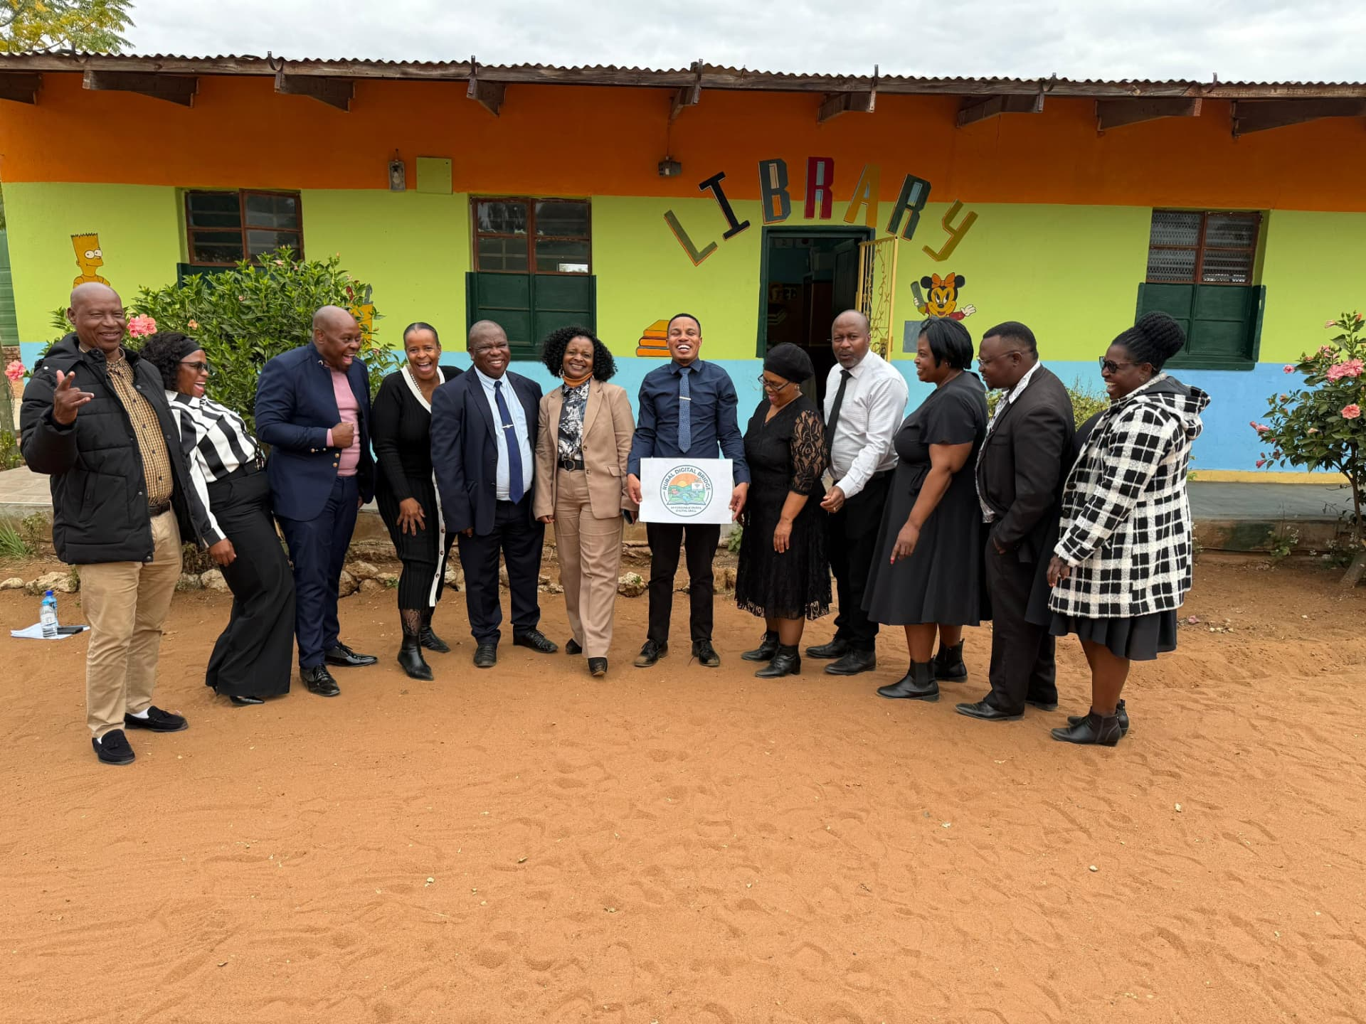
Developing Future Innovators
Coding and Robotics
Problem-solving
Computational thinking
Creativity
Innovation
Practical technology skills
Teamwork
Future career awareness
Digital confidence
From the computer laboratory to national technology events — our learners are building the future.
Nong Modikwa Primary School · Digital Transformation Platform
23
Notes:
Coding and robotics build far more than technical skill — they build confidence.

Slide 24
News, Events and Announcements
Create once, review, approve, publish
Dashboard
Create Information
Review and Approve
Publish
Website
Announcements / News
AI Knowledge Base
Nong Modikwa Primary School · Digital Transformation Platform
24
Notes:
Nothing reaches the public before it is reviewed and approved.

Slide 25
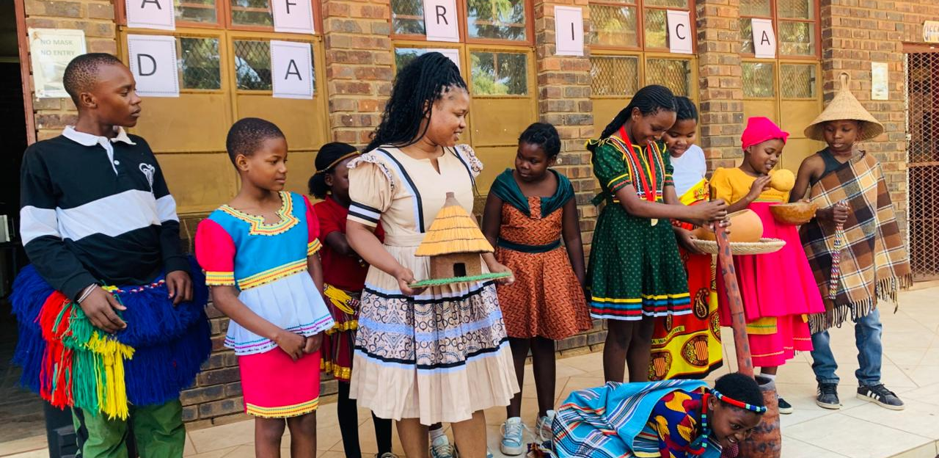
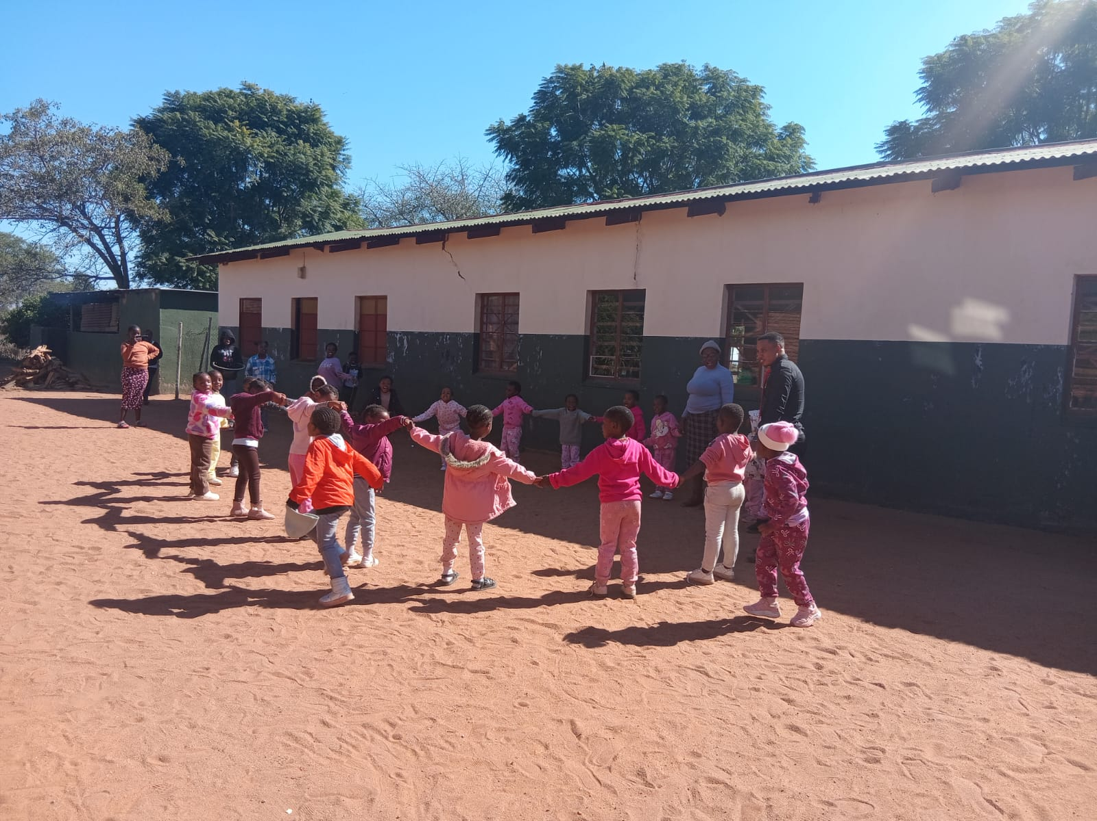
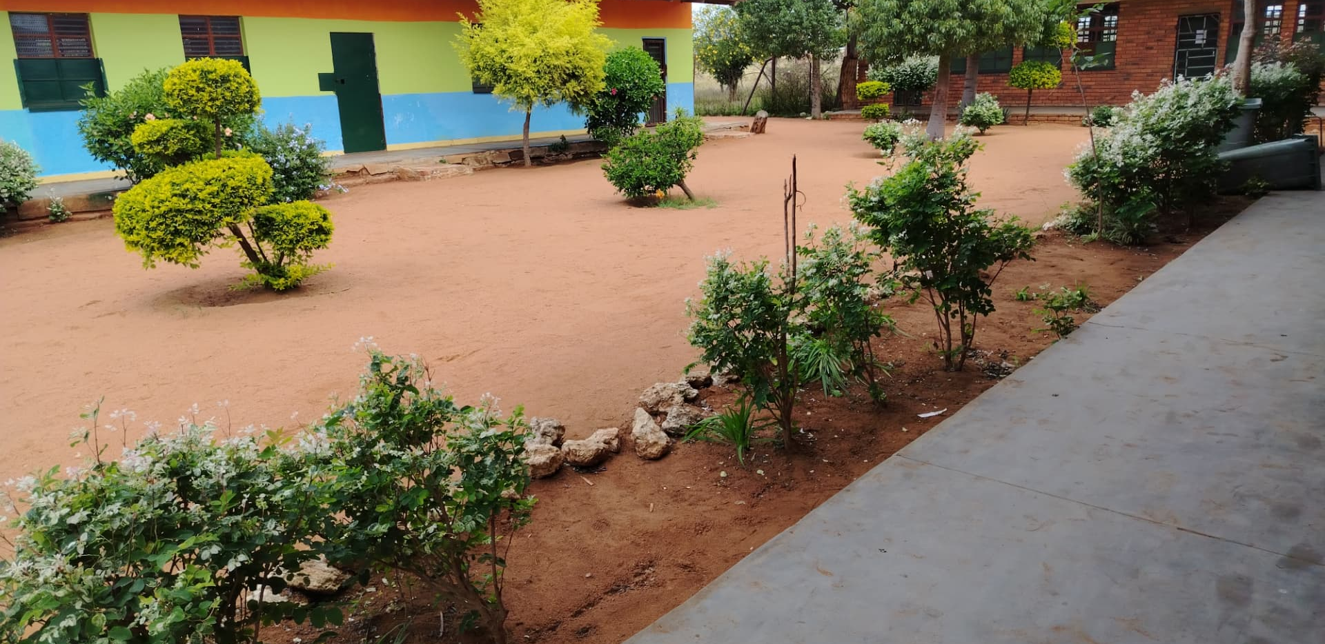
Digital Gallery
The life of the school, safely shared
Computer laboratory
Rural Digital Bridge
Cultural activities and heritage
Library
School events
School environment
Authorised users manage gallery content through the dashboard — public users have a secure viewing experience with no modification privileges.
Nong Modikwa Primary School · Digital Transformation Platform
25
Notes:
Authorised staff upload and organise photos; the public simply enjoys them.

Slide 26
Admissions
A clear, guided admissions experience
Grade R information
Age, readiness and required documents
Grade 1 information
Placement and registration steps
Online admissions guidance
Step-by-step application timeline
Requirements
Certified copies and proof of residence
Minimum age
Departmental age requirements explained
Feeder zone
Which villages the school serves
Smart Admit guidance
Answers to the most common questions
Live admissions page on the school website
Nong Modikwa Primary School · Digital Transformation Platform
26
Notes:
Parents can see exactly what is required before they visit the school.

Slide 27
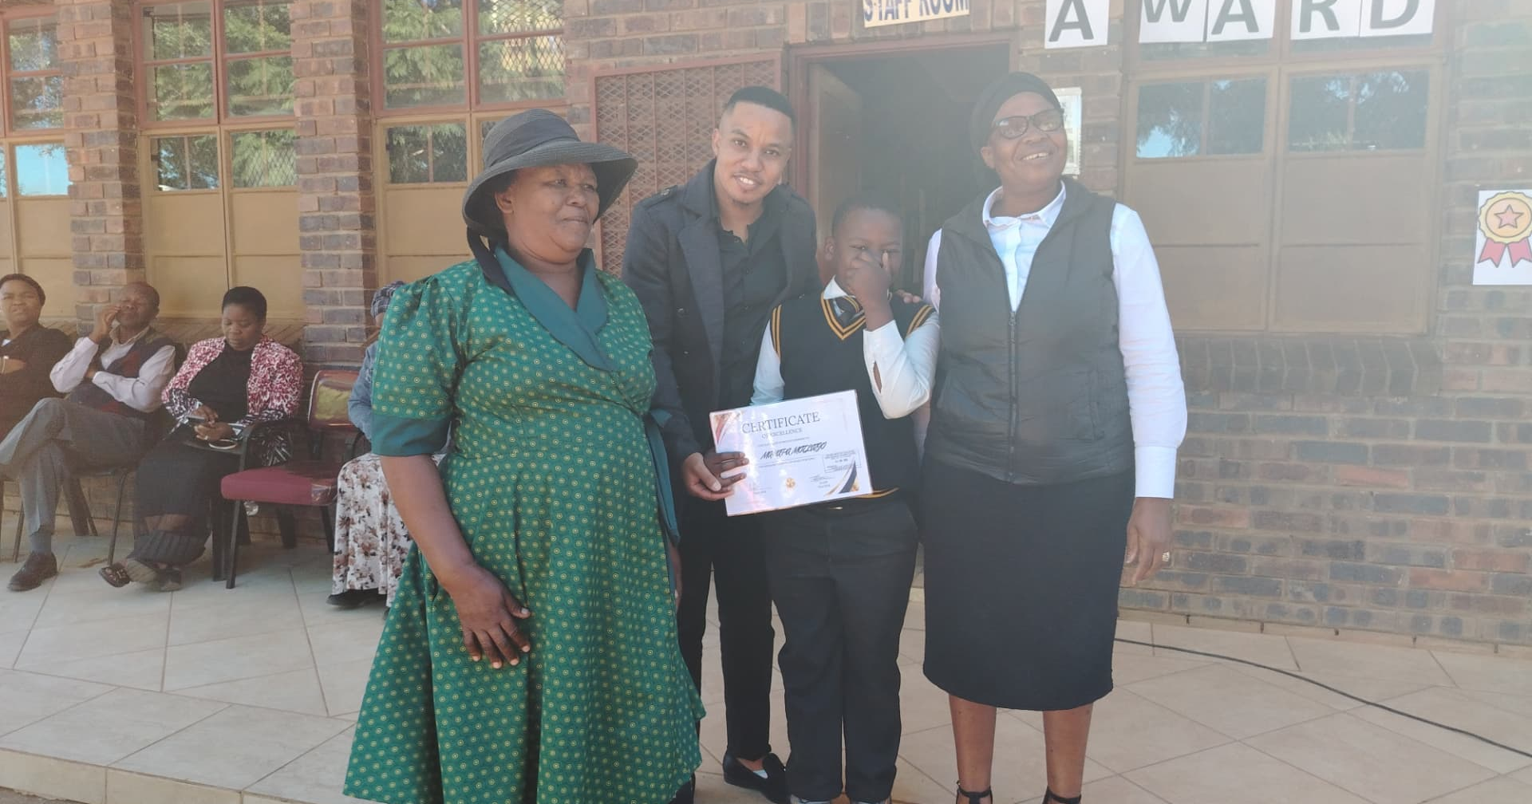
Celebrating Excellence
Achievements and certificates
Add achievements
Upload certificates
Upload photographs
Edit information
Publish achievements
Show them on the homepage carousel
STRIVE FOR EXCELLENCE
Every certificate published is a learner, an educator and a community celebrated.
Nong Modikwa Primary School · Digital Transformation Platform
27
Notes:
Recognition matters. The dashboard makes it easy to publish achievements.

Slide 28
Strategic Partnerships
Working with universities and education partners
University of Limpopo
UNISA
Tshwane University of Technology
Department of Basic Education
Limpopo Department of Education
Other approved partners
Research
Rural digital education research
Digital education
Shared programmes and resources
Teacher development
Professional growth and training
Coding and robotics
Curriculum support and equipment
Student teachers
Practical teaching placements
Community development
Skills that reach beyond the school
Nong Modikwa Primary School · Digital Transformation Platform
28
Notes:
Partnerships turn a school project into a research and development opportunity.

Slide 29
Impact
What changes for every group
LEARNERS
EDUCATORS
MANAGEMENT
PARENTS AND COMMUNITY
PARTNERS
Better access
Digital skills
AI support
Coding and robotics
Learning resources
Digital tools
Central information
Lesson planning support
Assessment clarity
Better administration
Central dashboard
Controlled access
Audit and accountability
Improved communication
Easy access to information
Transparency
Collaboration
Visibility
Research opportunities
Nong Modikwa Primary School · Digital Transformation Platform
29
Notes:
Summarise the practical benefits for each stakeholder group.

Slide 30
Future Developments
Where the platform goes next
WhatsApp integration
Reach parents where they already are
AI-powered WhatsApp communication
Instant answers to common questions
Parent communication
Targeted notices and reminders
AR school navigation
Augmented-reality guidance around the campus
Expanded digital library
More titles and digital reading
Advanced AI support
Deeper learning assistance
Stronger cybersecurity
Continuous protection and auditing
More coding and robotics
Wider participation across the grades
Future authorised integration
Only with approved systems and official permission
Any future integration with official departmental systems would only happen with proper authorisation.
Nong Modikwa Primary School · Digital Transformation Platform
30
Notes:
These are planned directions, not promises of integration with official systems.

Slide 31
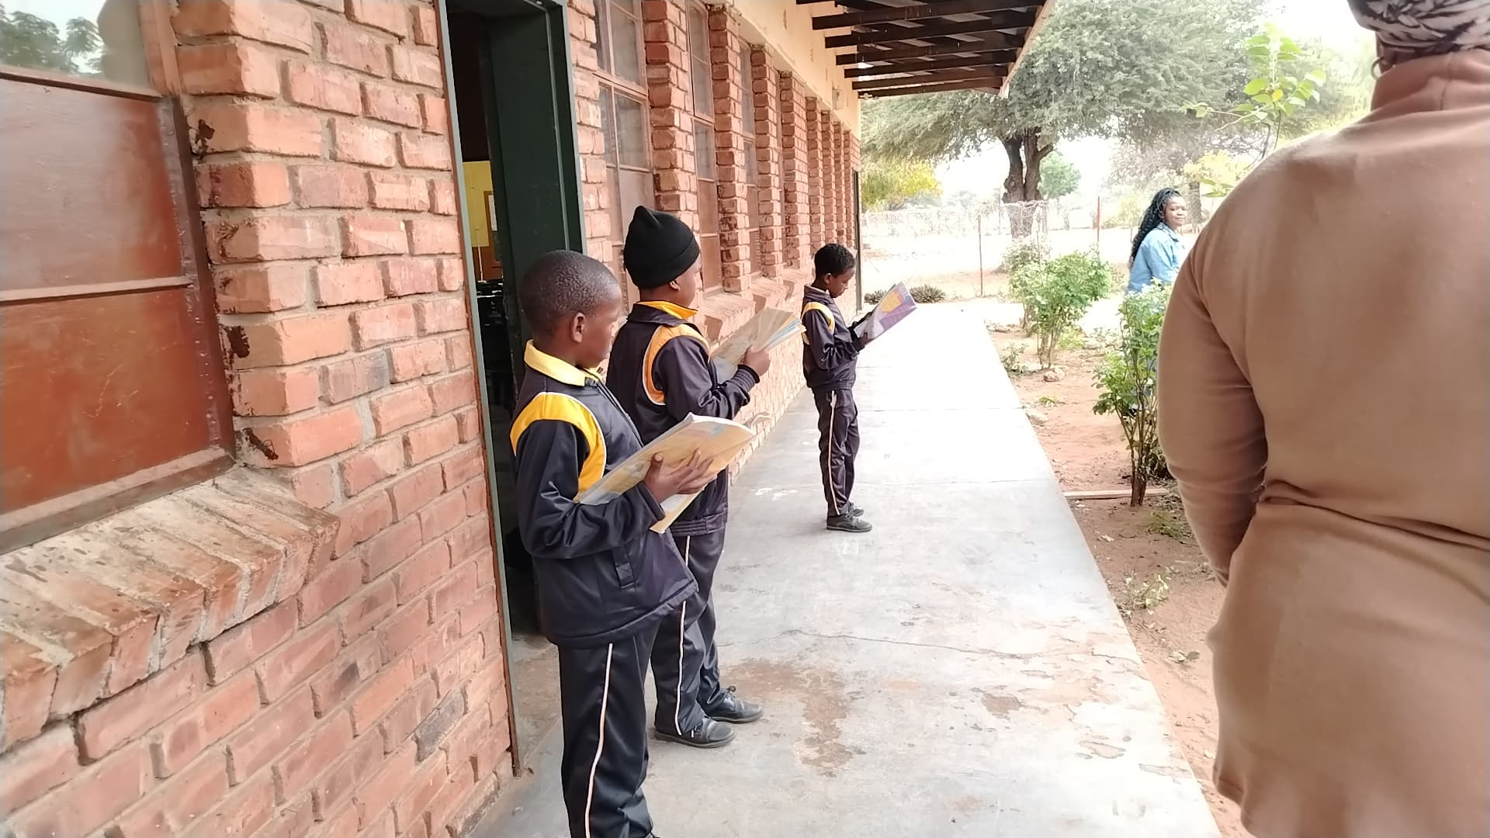
Our Future Vision
From a rural community to a future-ready generation
Rural Community
Access to Technology
Digital Skills
Innovation
Opportunity
Future-Ready Learners
Community Development
Our goal is not simply to use technology — it is to use technology meaningfully to create access, develop skills, improve education and expand opportunities.
Nong Modikwa Primary School · Digital Transformation Platform
31
Notes:
Close the story: technology is the means, opportunity is the goal.

Slide 32
Building a Digitally Empowered School
Conclusion
Nong Modikwa Primary School is taking practical steps towards building a modern, connected and innovative learning environment.
The Digital School Platform
The AI School Assistant
The Management Dashboard
Rural Digital Bridge
Coding and Robotics
Digital Library
LTSM Systems
AI Lesson Planning
Role-Based Security
Strategic Partnerships
Together we are improving access to information, strengthening digital skills
and preparing our learners for a rapidly changing world.
Nong Modikwa Primary School · Digital Transformation Platform
32
Notes:
Summarise the practical steps already taken.

Slide 33
Education, Innovation and the Future
“Education is the most powerful weapon which you can use to change the world.”
— Nelson Mandela
At Nong Modikwa Primary School, digital transformation is not only about technology.
It is about creating opportunities. It is about connecting rural learners to knowledge, innovation and the future.
It is about ensuring that where a learner comes from does not limit where that learner can go.
Through the Digital Transformation Platform and the Rural Digital Bridge Programme, we are preparing our learners for a rapidly changing digital world.
STRIVE FOR EXCELLENCE · NONG MODIKWA PRIMARY SCHOOL
THANK YOU — Questions and Discussion
Nong Modikwa Primary School · Digital Transformation Platform
33
Notes:
Thank the audience and open the floor for questions and discussion.

